Slide 1
From Policy to Practice: Commissioning that works for children
Children’s Commissioner’s office

Slide 2
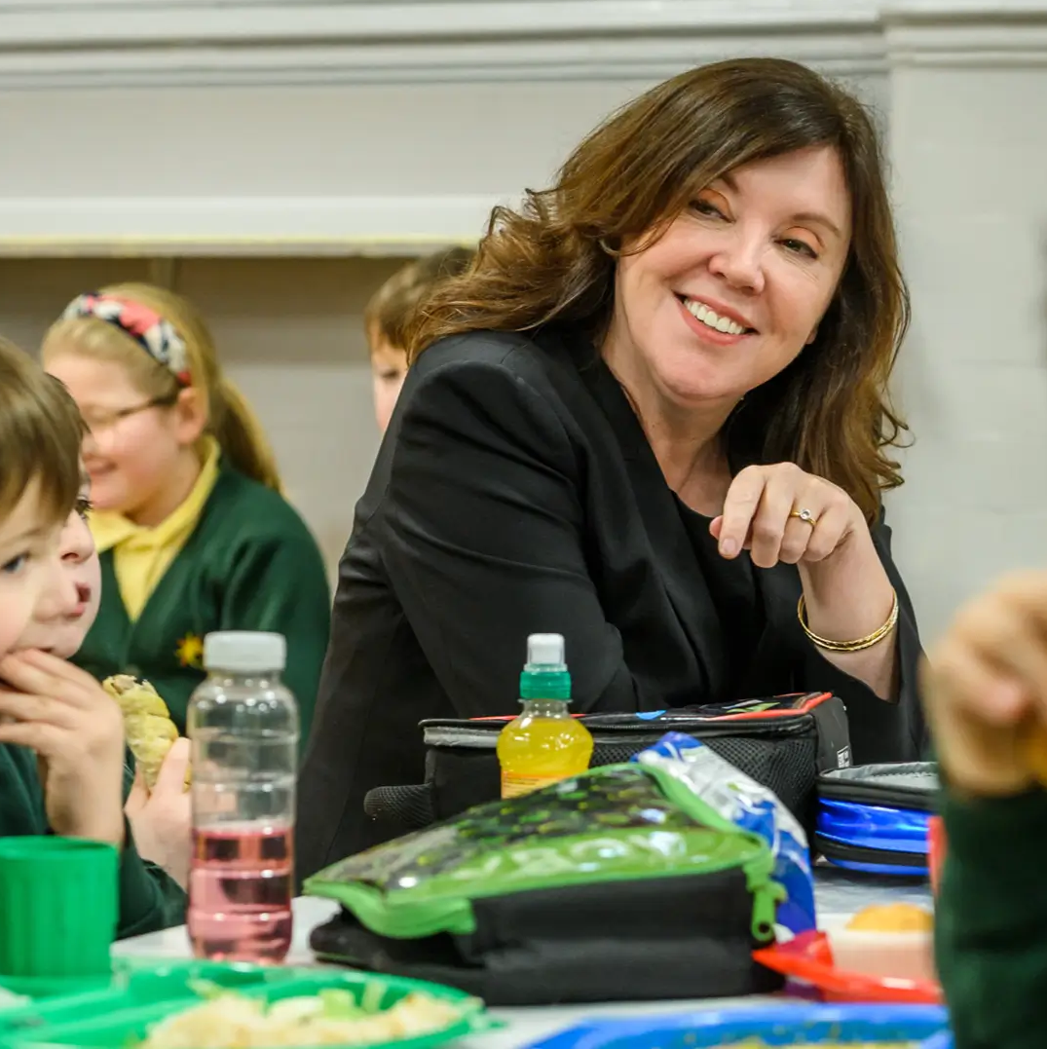
The Children’s Commissioner
Dame Rachel de Souza is Children’s Commissioner for England.
Her role is to promote and protect children’s rights, by making sure their voices, views and experiences are heard.
She has unique statutory powers to achieve this, including:
Section 2C – power of reply
Section 2E – power of entry
Section 2F – data power
Help at Hand – Advocacy Service
Notes:
Independent from government and has unique statutory powers
Section 2C – power of reply
The Commissioner can compel public bodies and public servants to respond to the recommendations in my reports.
Section 2E – power of entry
The statutory powers also allow the Commissioner to enter any premises or buildings where children are cared for.
Section 2F – data power
The Commissioner is able to request data from public bodies exercising a function toward children about their views, experiences and outcomes

Slide 3
Children in illegal children’s homes
‘Summer’, was moved between four different homes in six months before being placed in an illegal children’s home, surrounded by staff who spoke limited English, without facilities to wash and left to support herself with meals and finances as though she were an adult.
‘Amelia’, whose increasingly destructive behaviour made it impossible for her to live at home with her parents, has lived in every kind of illegal placement: caravans, hotels and rented holiday accommodation. Unsurprisingly, none have helped her with her behaviours.

Slide 4
Data request
The office found:
A slight decrease in the number of children placed in unregistered children’s homes compared to 12 months previously.
The request to all local authorities in England found 669 children in unregistered homes on 1st September 2025, down 12% from 764 on the same day last year.

Slide 5
Who are the children in unregistered homes?
Who are the children in unregistered homes?
Mirroring the picture last year, many of the children in these settings had known vulnerabilities:
Over half of children (59%) in unregistered placements had an Education, Health and Care Plan (EHCP) and a further 9.7% had special educational needs and/or disabilities (SEND) without an EHCP. 30% had no identified SEND.
Over a third of children in unregistered placements (36%) were in receipt of support from child and adolescent mental health services (CAMHS), and a further 7.0% were on a waiting list for these services.

Slide 6
What are the placements like?
Most unregistered placements (89%) were supplied by private providers, and 8.4% were provided by public providers. This is a small shift from last year – 94% were private providers.
Most children were placed in out-of-local-authority-area accommodation (61%) – compares to 44% of all LAC in out of area placements in March 2025.
The average weekly cost of an unregistered placement on 1st September 2025 was about £10,500, this is a small reduction from last year
Total estimated annualised cost £353m (weekly cost x 52), compared to £439m last year, but 36 children were in placements that had each cost in total more than £1 million.
Most often, children (59%) were placed in an unregistered ‘house’ and 44% in settings the local authority described as an unregistered children’s home.

Slide 7
Children in hospit5al
More than 260,000 children spent three or more weeks in hospital over their lives. This included:
70,000 children who spent three or more months in hospital.
1300 children spent over a year in hospital over their childhoods.
48 children spent over three years in hospital.
More than 14,000 children spend over 10% of their childhoods in hospital.

Slide 8
Barriers to leaving hospital
Children with social, emotional and mental health needs
A lack of specialist, therapeutic care for children with social, emotional and mental health needs in the community.
Children’s residential homes not being equipped to care for children with complex social, emotional and mental health needs and not accepting children with these needs.
Professionals finding it difficult to work across health and social care: Including engaging children’s social care and ICBs in finding a solution for children stuck in hospital.
Care placements being unsuitable for children’s needs leading to readmission.
“[Child had] been all over the country and yet another care home was saying, ‘No, not having you back’. And just the level of rejection and trauma that she must have been through her entire life.” - Lead Nurse for Safeguarding

Slide 9
The Big Future Survey
The Commissioner has launched The Big Future survey to hear from children and young people across England.
She wants to hear from children about how to make their lives better in the future, the big challenges growing up, and how prepared they feel to vote and be adults.

Slide 10
Complete the survey
Complete the survey here:
childrenscommissioner.gov.uk/thebigfuture

