Slide 1
Reinvigorating Commissioning
Peter Hay CBE A Bold Vision for Children and Young People
peter_hay@btinternet.com Birmingham 8th October 2025

Slide 2

Content
We can reinvigorate commissioning through:
Core values and processes
Engaging with the financing of care
Focusing upon value
An example of how hard diversity and equality are to achieve
A focus upon value

Slide 3

Commissioning
“Commissioning is the process of specifying, securing and monitoring services to meet people’s needs”
(Audit Commission 2003)
This is everyone’s business, involving collaboration with specialists who possess specific skills and expertise.

Slide 4
My baselines
Markets are the best way we have found to facilitate choice and control, but they need guardrails and rules.
Our lack of willingness to reform (especially adult social care) is an issue of social justice.
Building conversations about how we meet challenges, using evidence and willing to tackle “inconvenient truths.”

Slide 5
1/. Core values and processes

Slide 6
Four core values from Integrated Commissioning for Better Outcomes (2018)
Respect for the value and rights of each person
A belief in creating solutions together
Trust and confidence in the ability of others
Professionalism

Slide 7
Approaches to commissioning
Definition
ICBO Domains (to help you!) ¹
Analyse
Plan
Do
Review
Building the Foundations
A person-centred, place-based and outcomes-focused approach
Shaping provision
Continuously raising the ambition

Slide 8
Commissioning cycle under multiple pressures
Fragmented data
Weak links to lived experience
Safeguarding – early help
“Demand” thinking
Short-term, process measures, not outcomes
Accountability not aligned
Weak feedback from experience
“Space” to research, reflect, learn…
Analyse
Review
Plan
Integration & relationships – LGR/ICBs
Financial pressures
Market sufficiency
Weak on co-production
Spot purchasing
Market fragility
Workforce scarcity
Personalisation limited by risk/imagination
Do

Slide 9

Values and value of coproduction
Edgar Cahn, who founded Timebanks, argued that no society has enough money to raise children, care for adults, make neighbourhoods safe and address systemic injustice.
Public services are integral to our lives... my life, in which I want to be an active citizen, not a passive consumer or a burdensome “user”.
If we need to co-produce to add to resources, then we must consider how value is “co-owned”.

Slide 10
2/. Financing

Slide 11

Commissioning should engage with finance
To understand how the money works to deliver value for the people who draw upon care and support.
To know how the money is working for councils to meet their statutory duties. (And the self-funder?)
To demonstrate how the money benefits the council taxpayer. The protection of children’s spending has consequences in the public sphere that warrant debate.
To be curious about how the money is working to deliver excellent care today, tomorrow, and beyond.

Slide 12
It's about financing, not profits (1)
“In sum, there is widespread agreement from stakeholders, supported by the available data, that the market is currently failing to supply a sufficient supply of the right kind to ensure that local authorities can consistently place children in appropriate placements to meet their needs.” (CMA) ²
“Within parts of the social care market, local authorities are strongly reliant upon large providers who extract wealth from the care system, wealth that could otherwise be used to provide additional benefits for citizens and the state.” (Goodwin et al) ³

Slide 13
It's about financing, not profits(2)
IPPR describe the dominance of financial interests as a process of “financialisation”, which has seen an increasing role for economic motives, markets, and actors in shaping the delivery of care:
An expanding focus on real estate and property, with reliable public funding, rather than care, as drivers of the business model
A reliance on borrowing for funding, with high levels of debt
Astonishingly complex corporate structures, with multiple different subsidiaries and the use of offshore companies to minimise tax liabilities
Governance has focused on maximising the business's value to shareholders rather than delivering outstanding services and value to the taxpayer. ⁴
Horton makes a strong case that this system has extended into the use of labour. ⁵

Slide 14
3/. Mental Health for children and young people
( an illustrative example)

Slide 15

Mental Health
In 2023, the NHS spent £2.358 bn – 13.3% of its total mental health budget – sending mental health patients to private hospitals. This was £296m more than in 2022. ⁵
Data from NHS England shows that hospital admissions for mental health reasons have increased by 20 per cent since 2017 for 11 to 25-year-olds
Out-of-area placement volumes have been increasing despite a clear central policy objective to eliminate them.
45% of all looked after children in England have a diagnosable mental health condition (compared with 10% of all children) ⁶

Slide 16
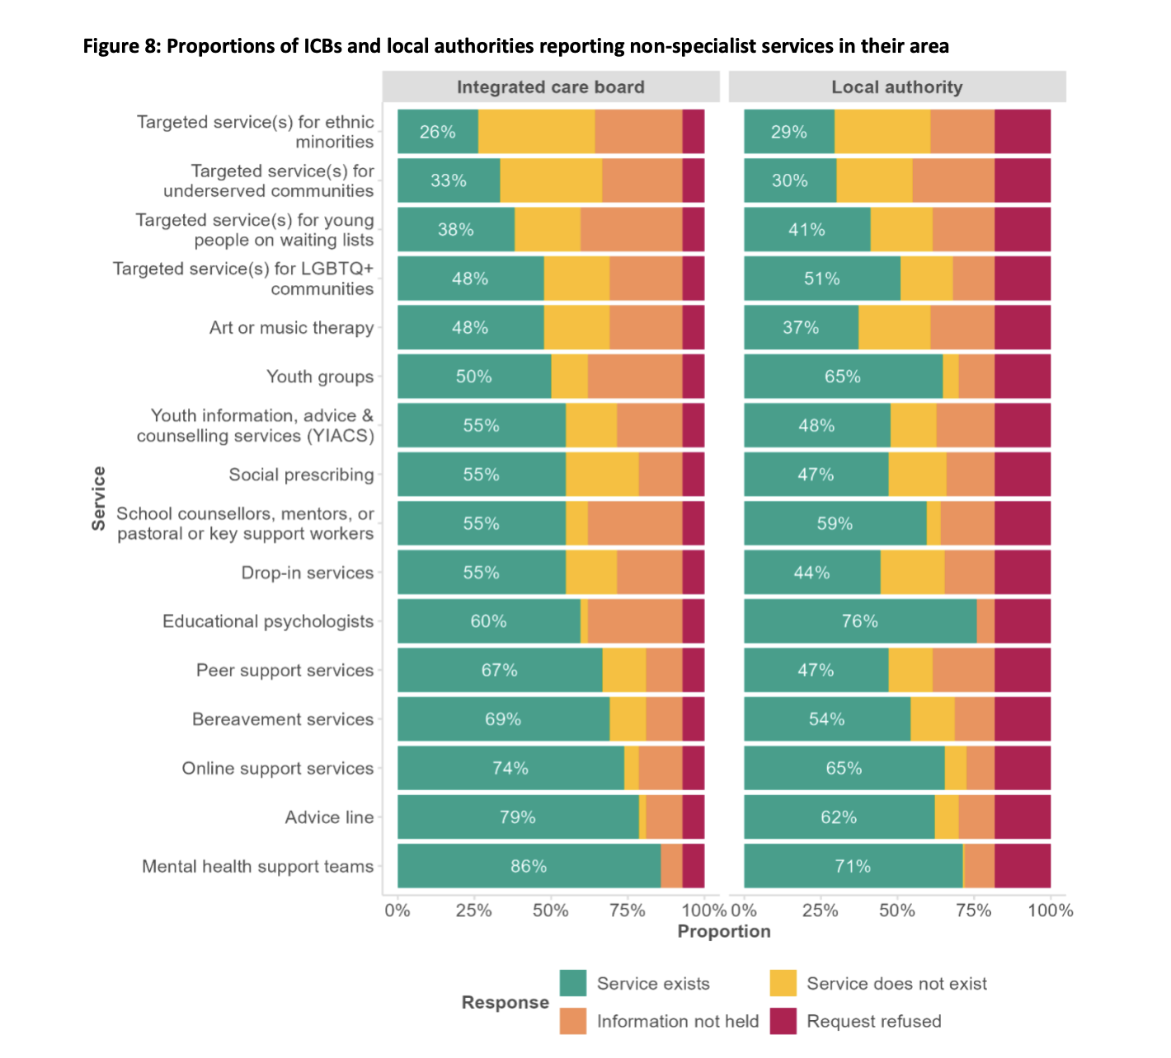
The core of respect and value for everyone
Half of the areas did not have a targeted service for LGBTQ+ young people, and two-thirds did not have any targeted service for young people from ethnic minority groups or for other underserved groups, including refugee and asylum-seekers or care-experienced young people. ⁷

Slide 17
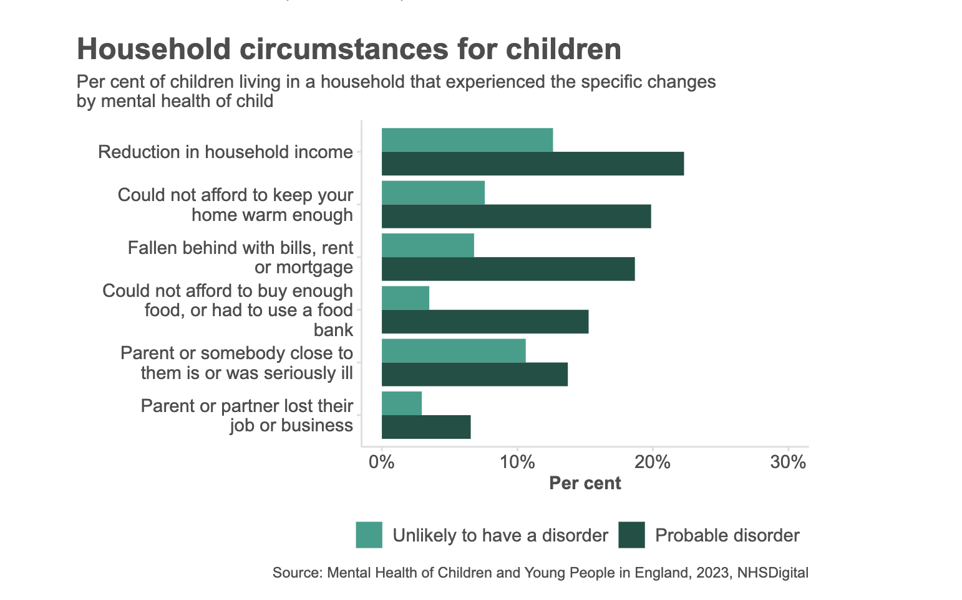
Broad, intelligent partnerships

Slide 18
4/. Focussing on value

Slide 19
A focus upon value
Shifting incentives to what matters to the child and family
Inequality and inequity are played out in the lives of children, and tackling this needs to be hardwired into what we do.
Better measurement – including what happens over time
Personal safety, psychological and emotional well-being, and educational progress are a good start.
Combined with the measurement of value in place, particularly through the workforce
Driving improvement and innovation through being able to show what good looks like
Creating guardrails that define what matters in this public space

Slide 20
Some steps along the way
Being led by values, Turning Point is “inspired by possibility” Honeycomb Group will “never shut the door”
Seriously valuing lived experience and its place in the workforce
Deep co-production (Holly House, Stafford – with the ICB)
Changing systems from within – Turning Point working with LDEngland on involvement and coproduction
Workforce – ThinkAhead and mental health
Wider roles and impact: look what warmer homes might do?! Thriving connected communities

Slide 21

Focus upon value
Real accountability should be to those who draw upon services.
Is there any reason great providers and commissioners wouldn’t want a child to know how the organisation works?
How do we create health and care?

Slide 22
Learning from all of social care
Horizons – the Lincolnshire Recovery Partnership's offer to young people
“ I would have never have gotten where I am today without you and your amazing support and honesty. There will never be a time I forget about the difference Horizon has made in my life.”
Young Person, Stamford

Slide 23


“You can not measure the meaning of turning on the lights behind one child’s eyes.” (Heifetz) Thanks for all your hard work to make an impact.

Slide 24
References
¹ LGA/NHS Clinical Commissioners (2018) Integrated Commissioning for Better Outcomes
CMA GOV.UK. (2022). Final report. https://www.gov.uk/government/publications/childrens-social-care-market-study-final-report/final-report
² Lloyd Goodwin, T., Burch, D. and McInroy, N. (2020). A progressive approach to adult social care CLES. [online] CLES. Available at: https://cles.org.uk/publications/a-progressive-approach-to-adult-social-care
³ Blakeley, G. and Quilter-Pinner, H. (2019). Who cares? Financialisation in social care. IPPR. https://www.ippr.org/research/publications/financialisation-in-social-care
⁴ Horton, A. (2019). Financialization and non-disposable women: Real estate, debt and labour in UK care homes. Environment and Planning A: Economy and Space.
⁵ LangBuisson (2024) Mental Health Market Report
⁶ House of Commons Education Committee, 2016, EHRC (2018) “Is Britain Fairer?”
⁷ EPI (2024) Non-specialist mental health support for young people in England
⁸ Health Creation Alliance (2024) Why Ownership Matters

