Slide 1

A Bold Vision for Children and Young People
Birmingham, 8th October 2025
Dr Jim Goddard
The Care Leavers’ Association
The Future of Children’s Services – What Needs to Change?

Slide 2


The Care Leavers Association
A User-led national charity – for care leavers by care leavers. Founded in 2000.
Our vision is for a “good life in care, a good life after care” – working to improve the care system and the lives of care leavers
The user voice needs to be at the heart of service delivery and design. Things can only be improved by listening to the user experience

Slide 3
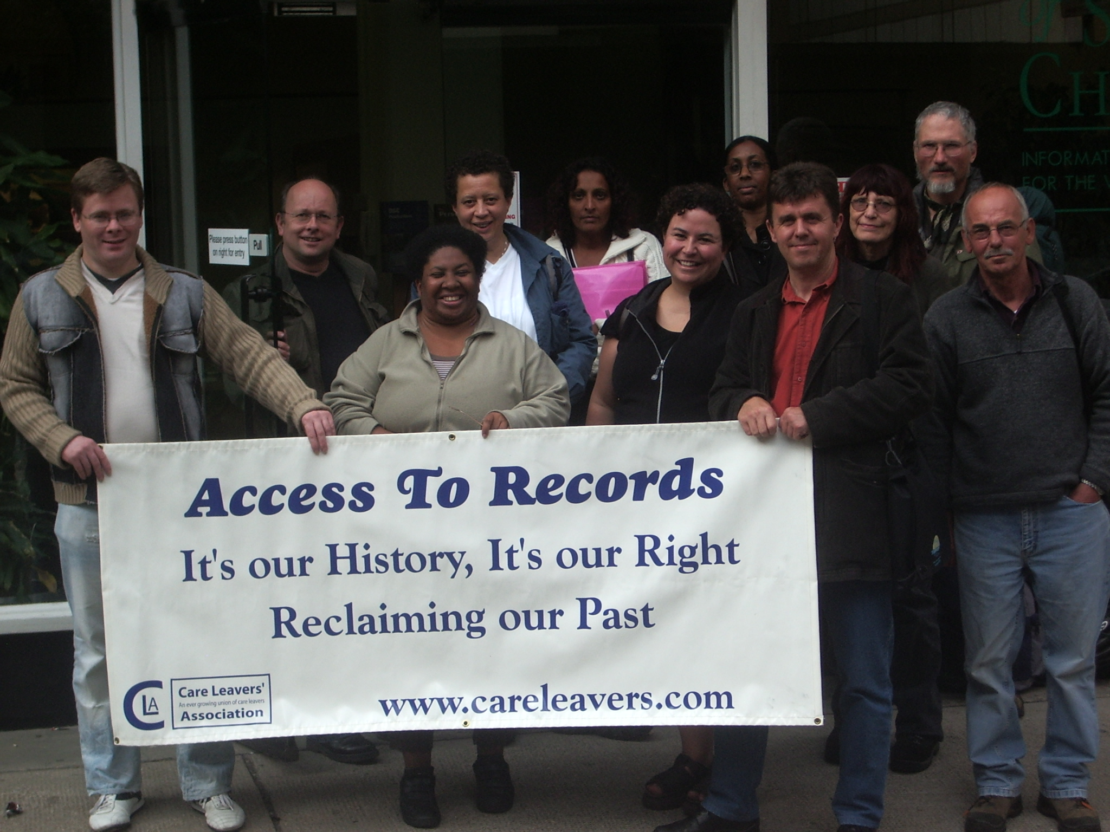
Our Recent Main Projects
The Criminal Justice System: Over-representation, Mentoring, Support
Young People and Older Care Leavers: Wellbeing and mental health, Isolation
Access to Child Care Records: Personal identity
Old Care Leavers: Making Connections
Policy: Prioritising the user voice

Slide 4
Plato (428-423 BC – 348-347 BC): The Laws, Book 11
“Thus will orphans have a second birth. In order to make their sad condition as light as possible, the guardians of the law shall be their parents, and shall be admonished to take care of them. And what admonition can be more appropriate than the assurance which we formerly gave, that the souls of the dead watch over mortal affairs? About this there are many ancient traditions, which may be taken on trust from the legislator. Let men fear, in the first place, the Gods above; secondly, the souls of the departed, who naturally care for their own descendants; thirdly, the aged living, who are quick to hear of any neglect of family duties, especially in the case of orphans. For they are the holiest and most sacred of all deposits, and the peculiar care of guardians and magistrates; and those who try to bring them up well will contribute to their own good and to that of their families. He who listens to the preamble of the law will never know the severity of the legislator; but he who disobeys, and injures the orphan, will pay twice the penalty he would have paid if the parents had been alive… the duty of the guardian in our state is the same as that of a father, though his honour or disgrace is greater. A legal admonition and threat may, however, be of service: the guardian of the orphan and the guardian of the law who is over him, shall love the orphan as their own children, and take more care of his or her property than of their own. If the guardian of the child neglect his duty, the guardian of the law shall fine him… When the orphan is of age, if he thinks that he has been ill-used, his guardian may be brought to trial by him within five years, and the penalty shall be fixed by the court.”

Slide 5
Outline:
The Care System
Leaving Care
Older Care Leavers
The 2022 Independent Review of Children’s Social Care.

Slide 6
The Care System
What is the Care System For?
Recovering from trauma
Providing Stability
Parenting

Slide 7
What is Trauma?
“Trauma results from an event, series of events, or set of circumstances that is experienced by an individual as harmful or life threatening. While unique to the individual, generally the experience of trauma can cause lasting adverse effects, limiting the ability to function and achieve mental, physical, social, emotional or spiritual well-being.” (Gov.uk: Office for health improvement and disparities)

Slide 8
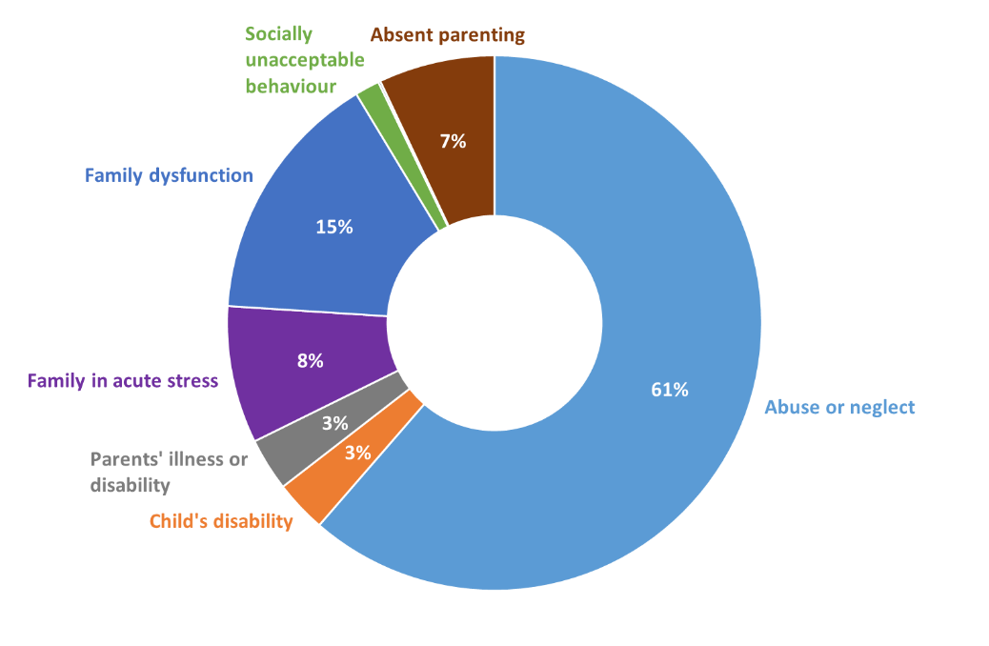
Proportions of looked after children by category of need - England, 2017 (average age of entry to care approx. 14):

Slide 9
Recovery from Trauma (and not adding to it)
Four sites of potential trauma connected to the care system:
Before entry to care (the majority enter due to abuse and neglect in the family)
The transition to care (the break, or near-break) with all former domestic ties)
During care (repeated placement breakdowns, abuse in the care system)
Leaving care (early leaving, vulnerability)
Given 1. and 2. logic suggests that all children in care need some form of therapeutic support to begin recovery from those experiences. This should therefore be the default assumption for all children entering care.

Slide 10
What do we need to do?
Improve the commissioning process to increase the number of placements that deliver therapeutic or emotional wellbeing support.
Improve the current Mental Health Assessment process for children in care
Ensure that care – foster care, residential care and any other kind – has trauma recovery at its centre.

Slide 11
Leaving Care
Frank Dobson (Labour’s first Minister for Health after 1997):
“We have a special responsibility to young people who are in care or who have left care. As their corporate parent we owe them a special duty… In developing the new arrangements I asked everyone to look at things from the point of view of the young people and to ask “Would this have been good enough for me when I was a child?” or “Would this be good enough for my own children?” I am determined that young people living in and leaving care will in the future get the same support, as far as possible, as other young people who are living at home and leaving home. This means a home to live or return to (sic), a shoulder to cry on, encouragement with work or school or college, someone to take you out for a meal or out for a drink, someone to help you with a bit of cash when you need it, somewhere to get the washing done.” (Department of Health, 1999: 5)

Slide 12
Leaving Care
‘The Right to Return, The Right to Remain’ (what all good parents routinely offer their children)
Most young people don’t leave home finally until the mid-twenties. This has increased over time. Many become ‘re-nesters’, going home when crisis hits years later.
The need for spare capacity in the system.
Activities support: hobbies and sports
Dealing with trauma-related behaviour, rather than using it as an excuse to deny further help or services.
Ending children leaving care before the age of 18, either formally or in practice.

Slide 13
Leaving Care
Care leavers in the secure estate are still care leavers: Need for a statutory instrument that combines the pathway plan with the sentence plan
The prevalence of buck-passing
Implement a Wellbeing and Mental Health Assessment process for care leavers 18-25
Ensure a mental health specialist is attached to all leaving care teams
Improve access to wellbeing and mental health services for care leavers

Slide 14
Why we think the way we do: CLA Casework (1)
A system built around children, not bureaucracy
Too many children fall through cracks because “thresholds aren’t met.” I’ve supported care leavers who were denied housing or left sofa surfing because the system only responded when they were already homeless or, ironically, because they were in stable employment.
Earlier, preventative support
Parents who are care-experienced are often targeted only once crisis has hit, leading to child removals. I’ve supported parents who begged for help long before proceedings, but no one stepped in until it was too late, or stepped in unnecessarily.
Stability and consistency of workers
One young person I supported had 12 different social workers in 18 months. Each change meant retelling their trauma and losing trust. The instability in workers mirrors instability in their whole lives.
Support beyond 18 (and 25)
I’ve worked with care leavers in their 30s, 40s, and even 60s who still struggle with trauma, identity, and practical barriers like ID. They are repeatedly told they’re “too old” for support, yet their needs don’t disappear.

Slide 15
Why we think they way we do: CLA Casework (2)
Holistic view of identity and belonging
Accessing records is a common battle. I’ve supported people left waiting years for files, only to get heavily redacted documents. This denies them the right to understand their own lives and families.
Cross-system collaboration
Care leavers I’ve worked with are bounced between services: housing blames social care, social care blames health, health blames the DWP. No one takes responsibility, and the young person is left stranded.
A workforce supported to care
Frontline workers often tell me they “don’t have time” to care properly. I’ve seen brilliant workers burn out under impossible caseloads. Children suffer when staff don’t have the time or emotional space to build relationships.
Removing stigma
A young man I supported was labelled “trouble” by his college purely because he was in care, not because of his behaviour. This stigma shapes opportunities and damages self-worth before a young person even has a chance.
Focus on transitions
I’ve worked with young people handed black bin bags to move placements at short notice, and care leavers suddenly cut off from support the day they turned 18. These abrupt transitions echo abandonment and deepen trauma.

Slide 16
Care Leavers over the age of 25
Learning about care history is an important aspect of developing a sense of identity for all care leavers. Current guidance only focuses on care leavers up to 25. Adult care leavers over 25 have to use the process of accessing information held under the data protection act. This can be hit and miss depending on local authority systems
Consider removing social care files from the data protection act and sitting them under separate legislation with improved guidance
Provide support to care leavers of all ages when accessing social care files
Signposting and advice can be cheap

Slide 17
The Independent Review of Children’s Social Care
Support for Care Leaver Parents.
Accommodation for 16-17 year olds.
Extending Corporate Parenting Responsibilities.
Making Care Experience a Protected Characteristic.
Lifelong Guardianship Order.
Extension of Staying Put and Staying Close.
Support for Accessing Files Beyond the Age of 25.
Failure to consider the positive case for residential care.
Little to no awareness of the value of involving care experienced people in the governance of the care system.
Insufficient focus on the inadequacies of the current leaving care system.

Slide 18
Final Points
The current care system and the value of imagination
Using the correct benchmark; what would good parents do?
“the disadvantage faced by the care-experienced community in our country should be the civil rights issue of our time.” (Josh McCallister, Children’s Minister, Maiden Speech to House of Commons, July 2024).

Slide 19
Dr Jim Goddard
The Care Leavers Association
Jim.goddard@careleavers.com

