Slide 1
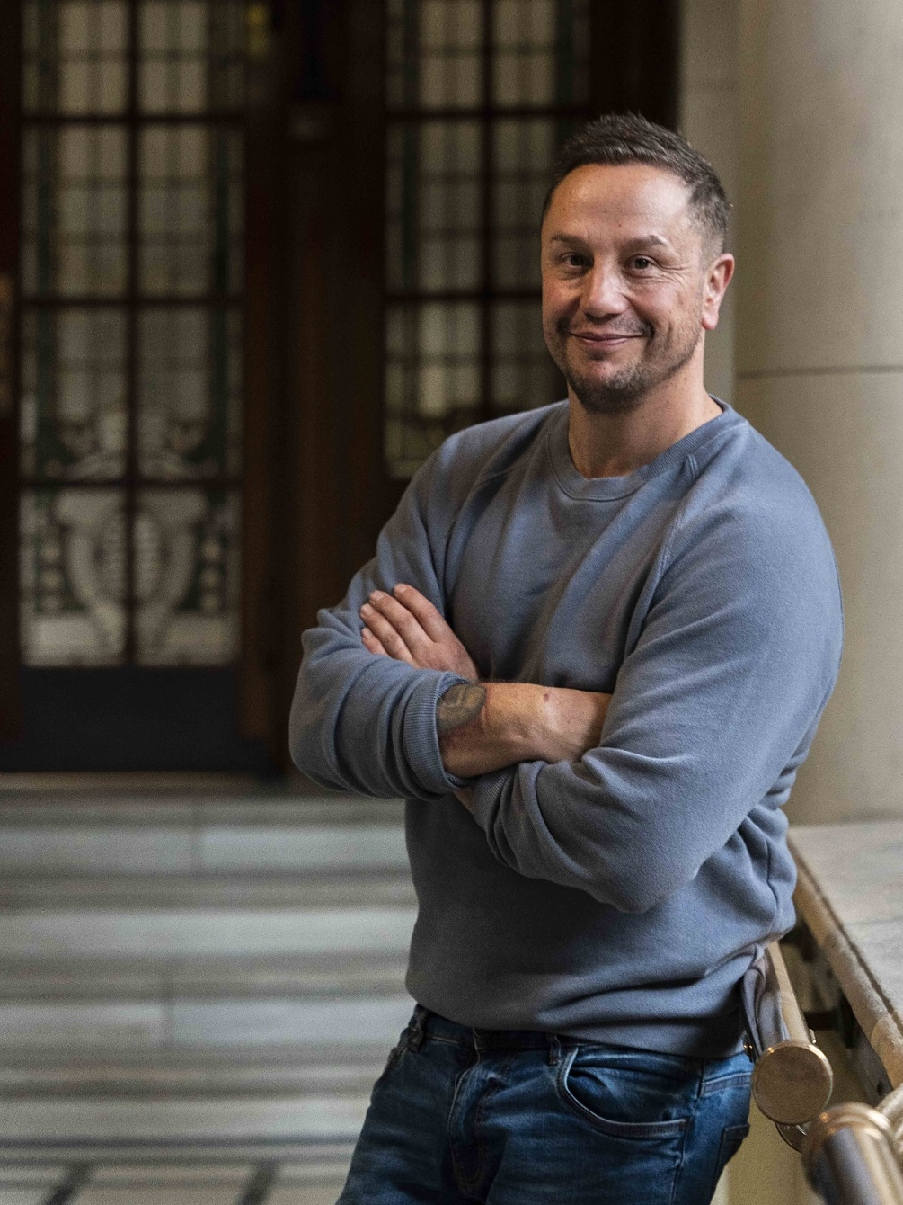

Chris Wild
Author
Campaigner
Care Leaver
All Round Legend

Slide 2
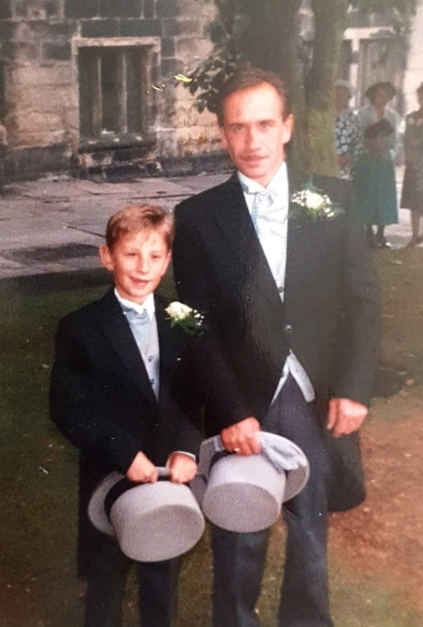

Slide 3
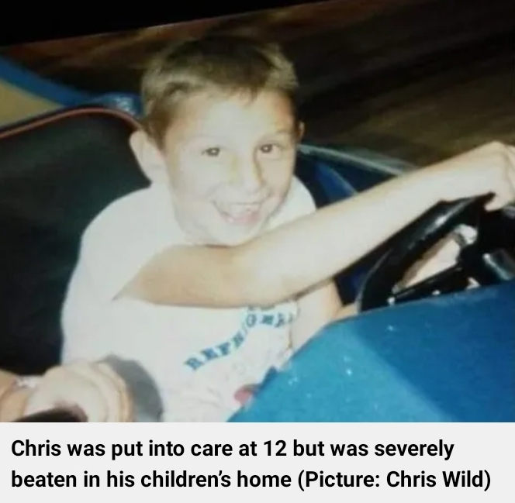

Slide 4


Slide 5


Slide 6


Slide 7

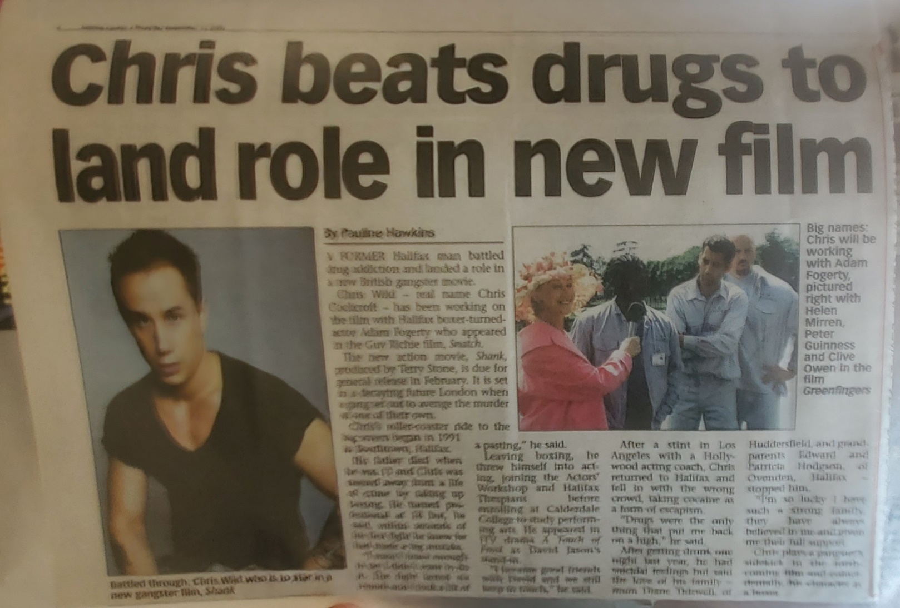

Slide 8


Slide 9
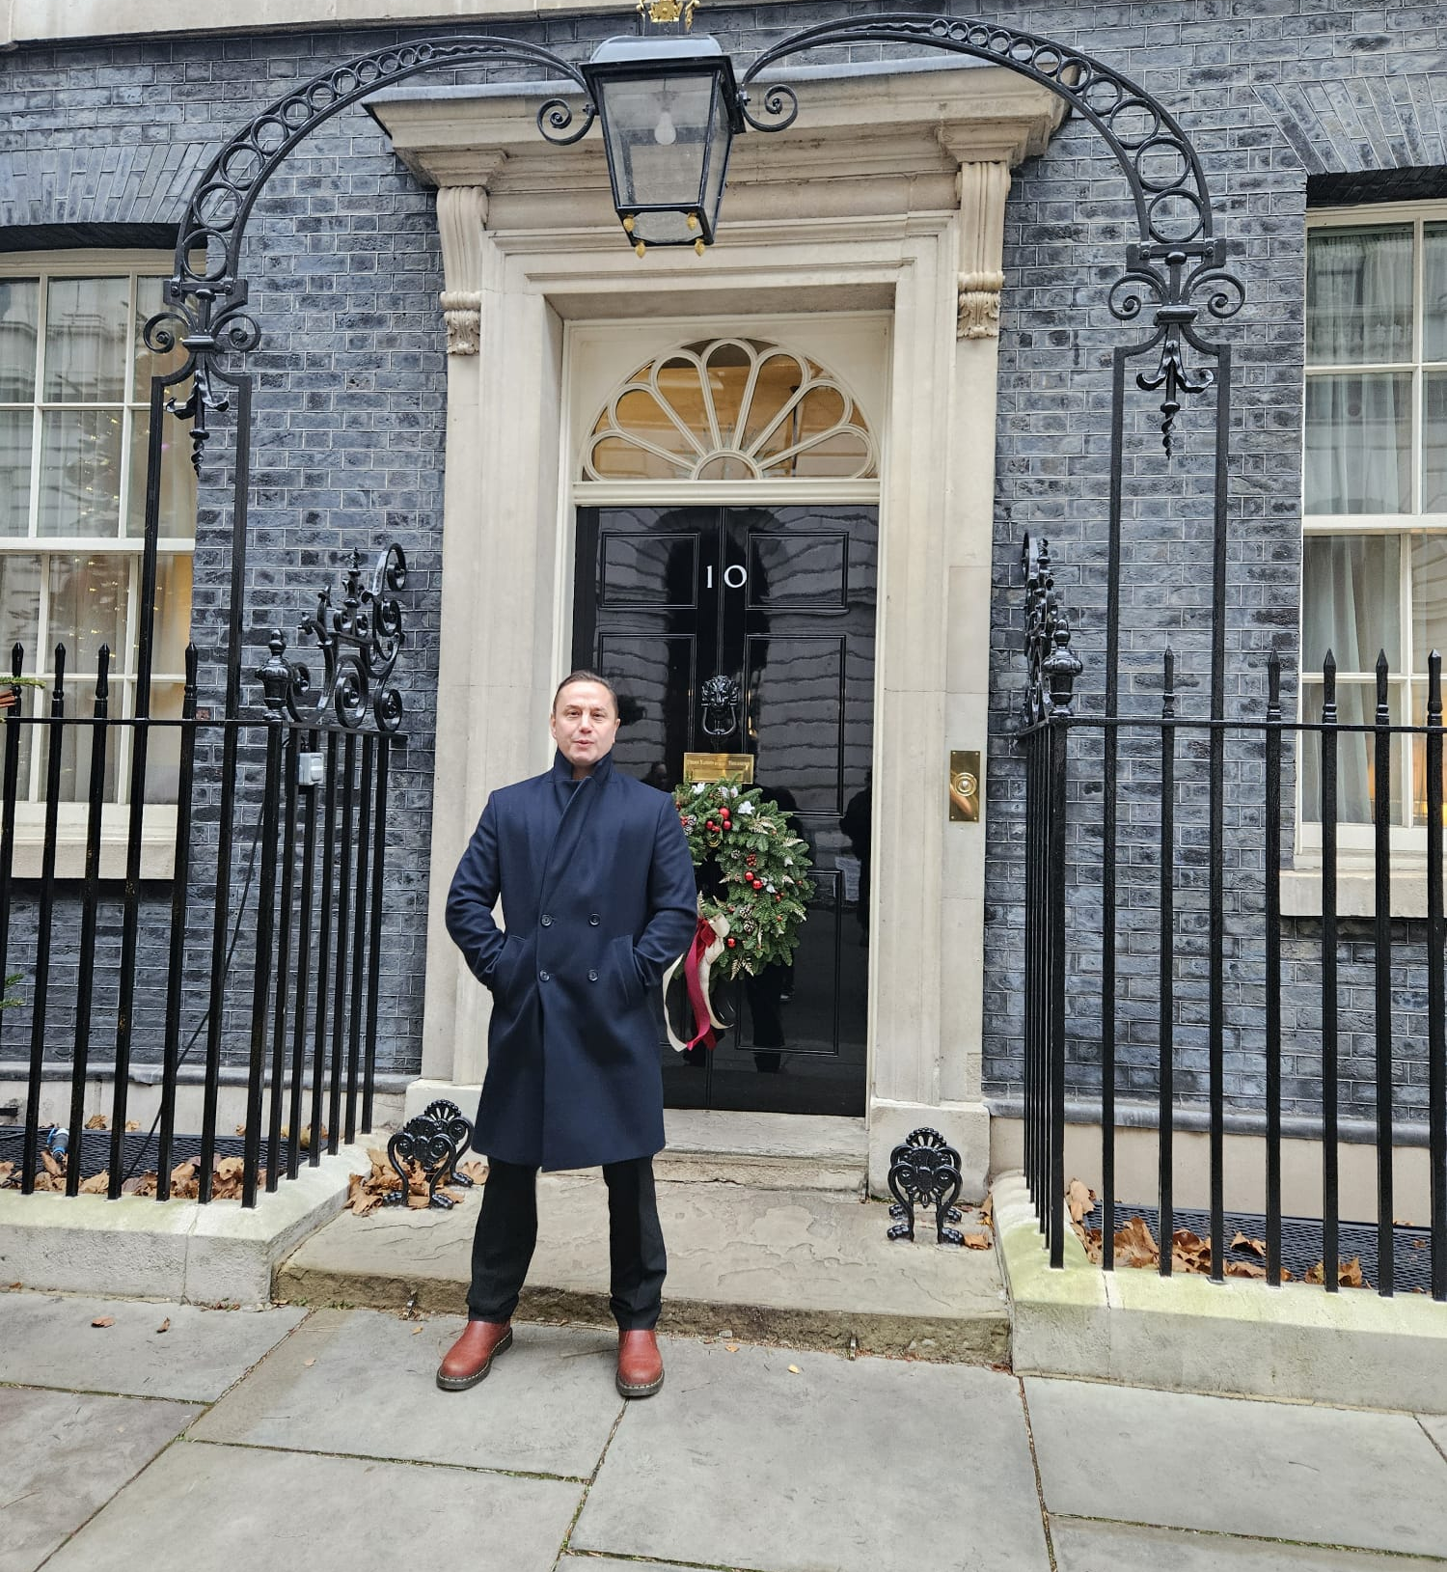
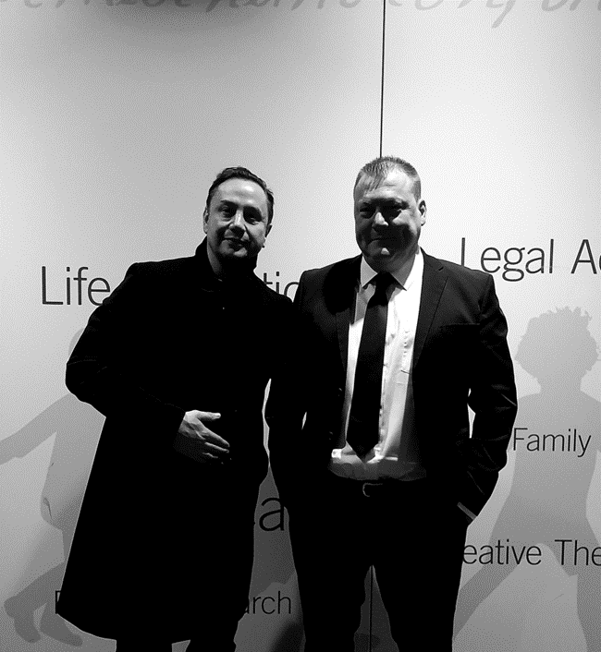

Slide 10


Slide 11
Children in Care Are Still Children
X @ccwild79 www.chriscwild.com

