Slide 1
Safeguarding Children in Unregulated Settings
Carolyne Willow

Slide 2
Outline
What do we mean by unregulated settings?
Harms, risks and calls for change
Regulation of supported accommodation
Safeguarding challenges of supported accommodation
Protecting children’s rights: what next for supported accommodation

Slide 3
1. Unregulated settings
Section 22C(6)(d) Children Act 1989 (5)If the local authority are unable to make arrangements under subsection (2), they must place [the child] in the placement which is, in their opinion, the most appropriate placement available. (6)In subsection (5) “ placement ” means— (a)placement with an individual who is a relative, friend or other person connected with [the child] and who is also a local authority foster parent; (b)placement with a local authority foster parent who does not fall within paragraph (a); (c)placement in a children's home in respect of which a person is registered under Part 2 of the Care Standards Act 2000 …; or
(d)subject to section 22D, placement in accordance with other arrangements which comply with any regulations made for the purposes of this section.

Slide 4
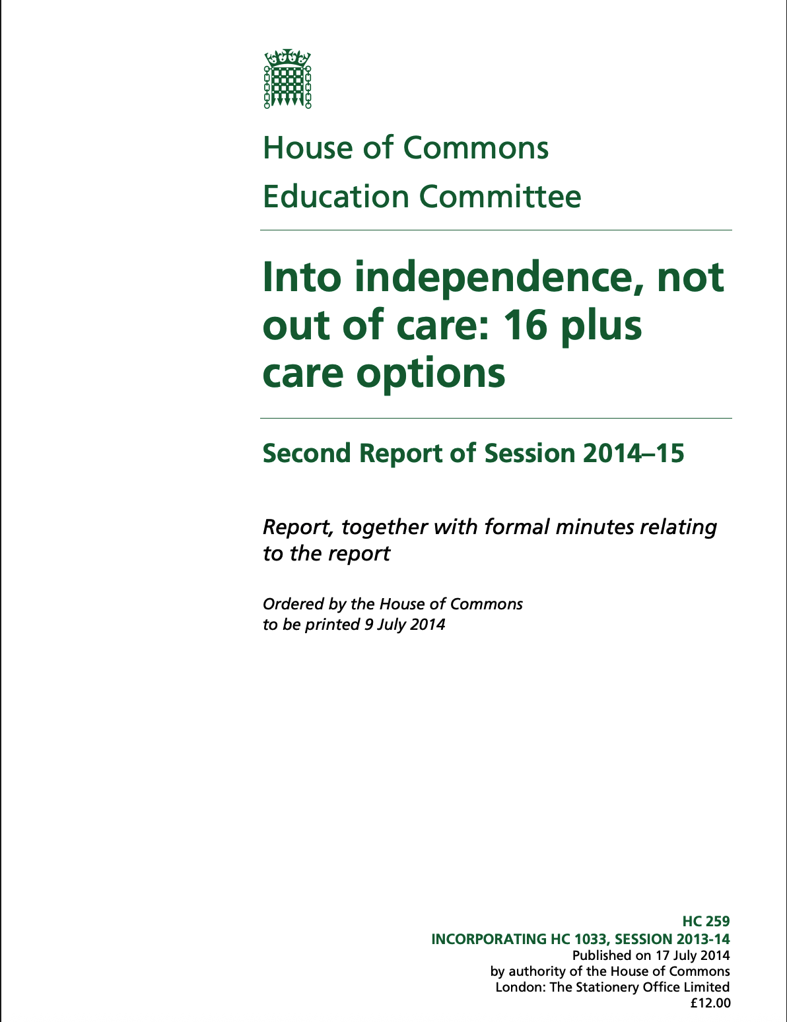
2. Harms, risks and calls for change
2014

Slide 5
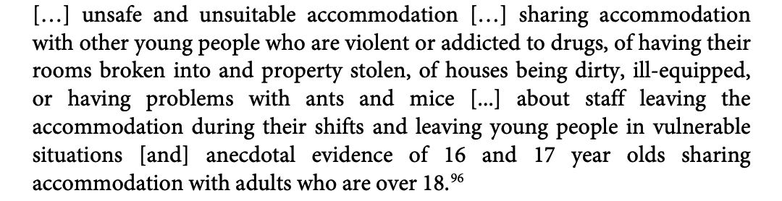
Evidence from Who Cares? Trust (now Become)

Slide 6
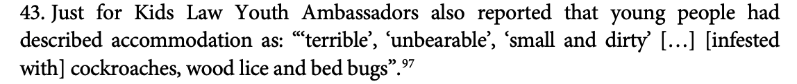

Slide 7
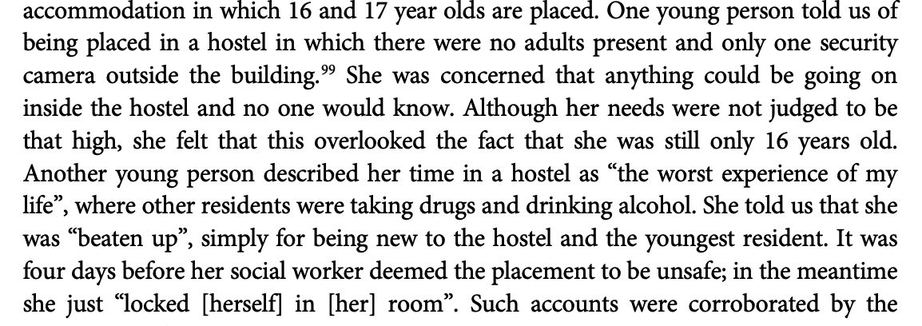
Direct evidence from young people

Slide 8
‘Other arrangements’ for looked after 16 and 17 year olds are too often neither safe nor suitable, a situation exacerbated by the lack of a regulatory regime for this kind of accommodation. The diversity of the provision presents difficulties for the implementation of stronger, universal regulation, but the challenges are not so great as to justify the continuation of inadequate and ineffective quality assurances for ‘other arrangements’.
We recommend that the DfE consult on a framework of individual regulatory oversight for all accommodation provision that falls within the category ‘other arrangements’ to ensure suitability while allowing for continuing diversity of provision.

Slide 9
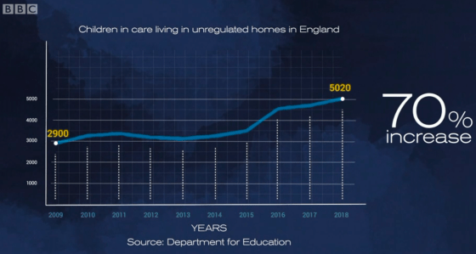

Slide 10
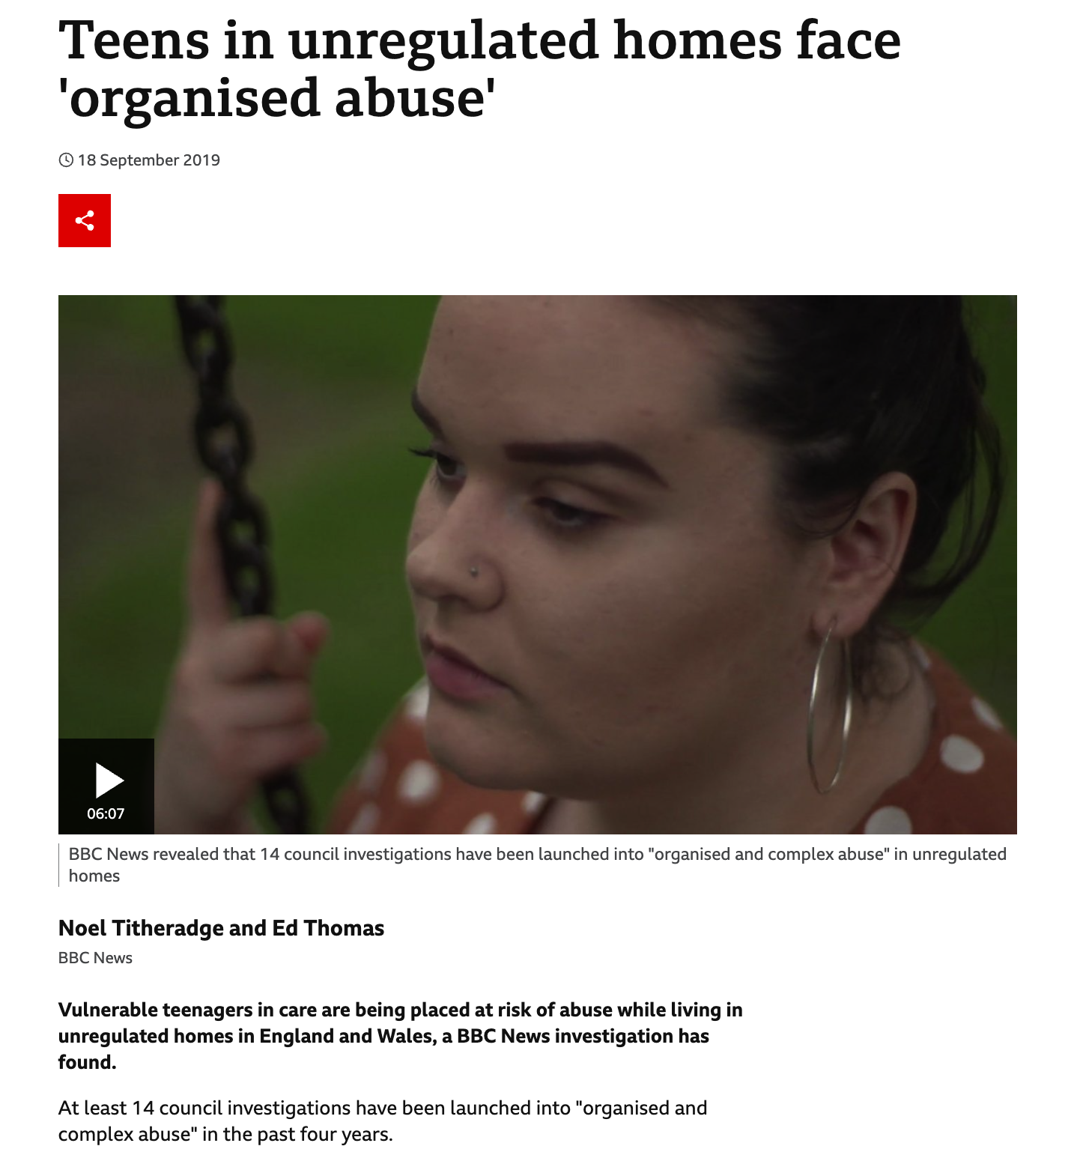

Slide 11
2019 – at least 14 local authority investigations into organised abuse
in past 4 years

Slide 12
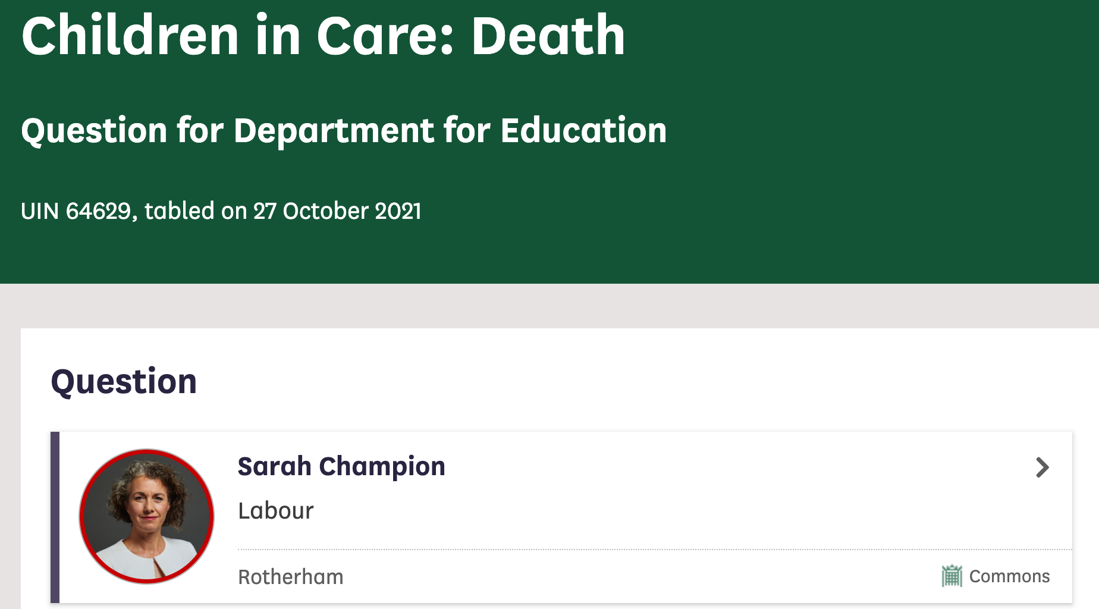
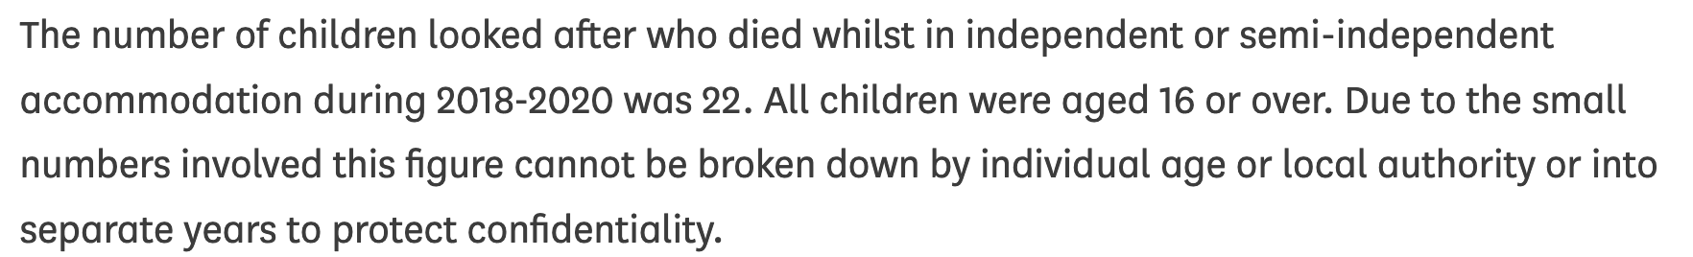

Slide 13
22 children in care died in unregulated settings in two years (2018-20) All aged 16 or 17

Slide 14
22 children in care died in unregulated settings in two years (2018-20) All aged 16 or 17
BBC Newsnight: of four children in care who died in unregulated settings between April and September 2020, three had taken their own lives

Slide 15

National campaign launched January 2020

Slide 16
Care-less accommodation

Slide 17
“It’s like a house without parents”
Care Leavers Forum discussion of unregulated accommodation, June 2020 (published by Article 39)

Slide 18
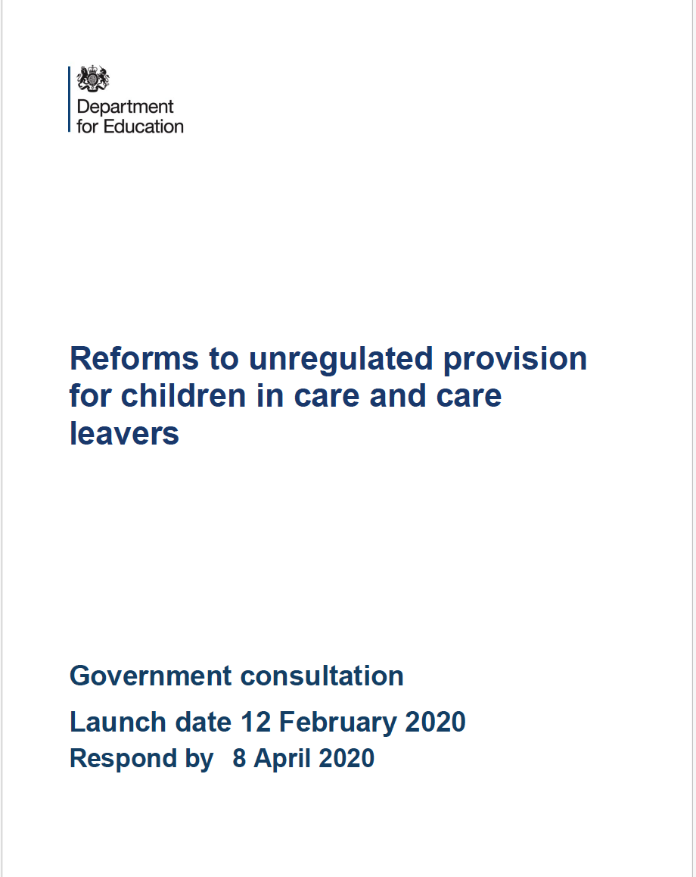
3. Regulation of supported accommodation

Slide 19
3. Regulation of supported accommodation
Aged 16 and 17
As children grow up … they gradually gain more independence from their parents … the care system seeks to replicate this with a transition to independence that begins at 16, when a young person could ask to leave care or to move to semi-independent accommodation. This form of provision can therefore be appropriate for older children where it is part of a carefully managed transition to independence as part of their care plan…

Slide 20
3. Regulation of supported accommodation
Aged 15 and under
Many children in the care system under the age of 16 are very vulnerable and often have complex needs. We do not believe that independent and semi-independent settings can meet all of these needs and therefore children of this age should not be placed in these settings under any circumstances.

Slide 21
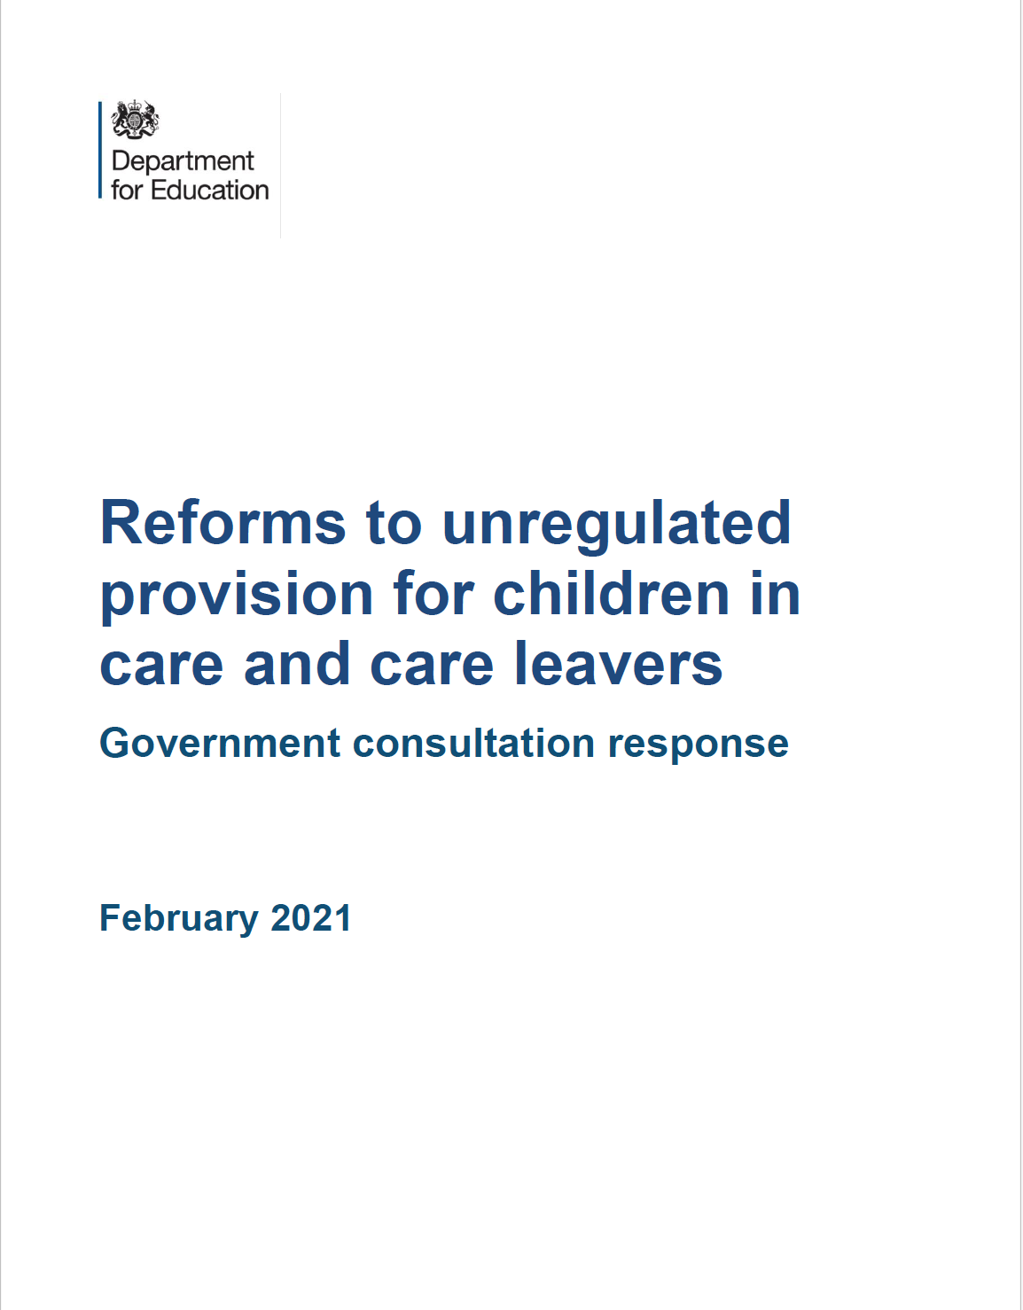
3. Regulation of supported accommodation
I cannot imagine a circumstance in which a child under the age of 16 should be placed in a setting that does not provide care… Gavin Williamson MP, Secretary of State for Education February 2021

Slide 22
3. Regulation of supported accommodation
The Care Planning, Placement and Case Review (England) (Amendment) Regulations 2021
The Supported Accommodation (England) Regulations 2023

Slide 23
4. Safeguarding challenges of supported accommodation
No day-to-day care
No ban on corporal punishment; no prohibited measures of control
No requirement for staff on premises 24 hours
No minimum qualification requirements
No independent monthly safeguarding checks
2 of 3 group living categories = children and adults in same property
Minimum inspection frequency every 3 years; only a sample of properties; and 2 days’ notice

Slide 24
4. Safeguarding challenges of supported accommodation
At least 40% of children in care aged 16 and 17 now live in supported accommodation (compared to around 22% in 2009)
Most common type of accommodation – child lives alone (‘self-contained unit’)
First 50 full inspections in 2024/25 (recalling inspection arrangements are inferior to children’s homes)
26 (52%) providers (not homes) consistently good
19 (38%) providers (not homes) inconsistent quality
5 (10%) providers (not homes) serious or widespread weaknesses

Slide 25
4. Safeguarding challenges of supported accommodation
Regulation 27 notification of serious events
2024/25; 490 Ofsted registered providers
320 notifications of known or suspected sexual exploitation or child criminal exploitation
140 allegations of abuse against provider or a person working there
29 mandatory referrals to the Data and Barring Service
1,820 other serious incidents

Slide 26
4. Safeguarding challenges of supported accommodation
National Audit on Group-Based Child Sexual Exploitation and Abuse Baroness Casey, June 2025
… many of the children affected by child sexual exploitation have not always been afforded the status of a child that is available to someone from a stable supportive home environment. Being in care almost fast-tracks children into adulthood – living in residential settings, or ‘semi-independent housing’ long before a child whose family is able to take care of them would do so.

Slide 27
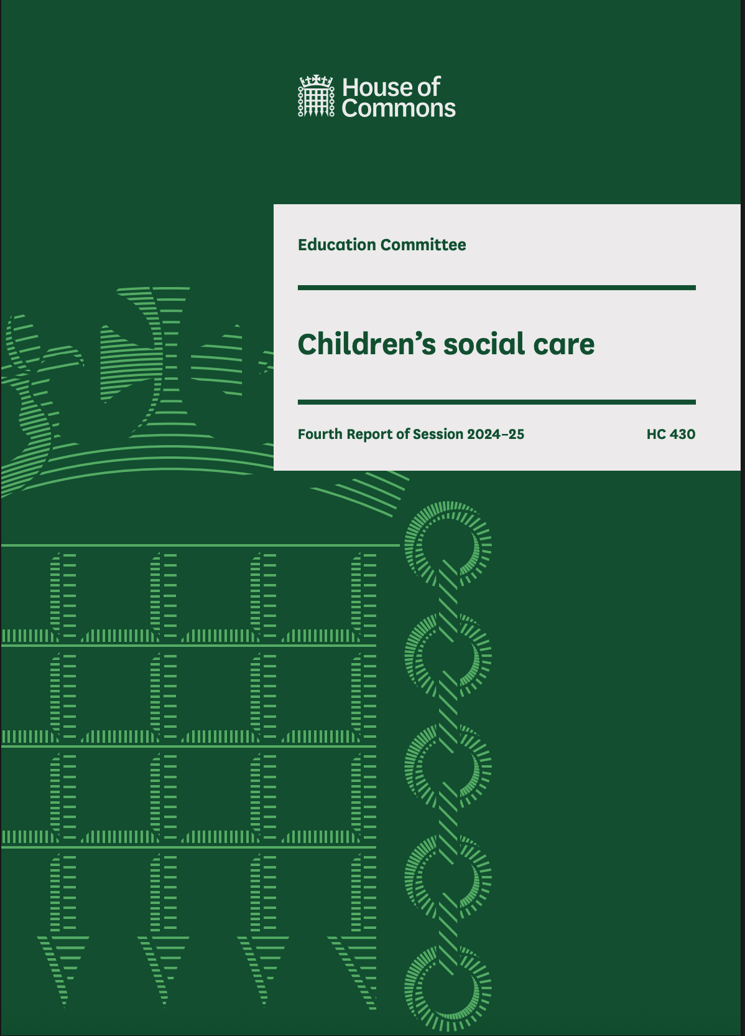
5. Protecting children’s rights: what next for supported accommodation
House of Commons Education Committee July 2025
CONCLUSION … the Department for Education needs to go further and ensure that all children under 18 receive care where they live, rather than simply support.

Slide 28
5. Protecting children’s rights: what next for supported accommodation
Amend The Children's Homes (England) Regulations 2015 – so all group-based settings provide care
Amend the Children’s Wellbeing and Schools Bill so that the care given to a looked after child must be that which it would be reasonable to expect a parent to give
In partnership with the care experienced community, reformulate supported accommodation as provision for older care leavers

Slide 29
carolyne.willow@tbgbarrister.co.uk

