Slide 1
Tackling child exploitation: identifying, protecting and preventing harm
Nick Cook
Director of Young People's Services
@childrenssociety.org.uk

Slide 2
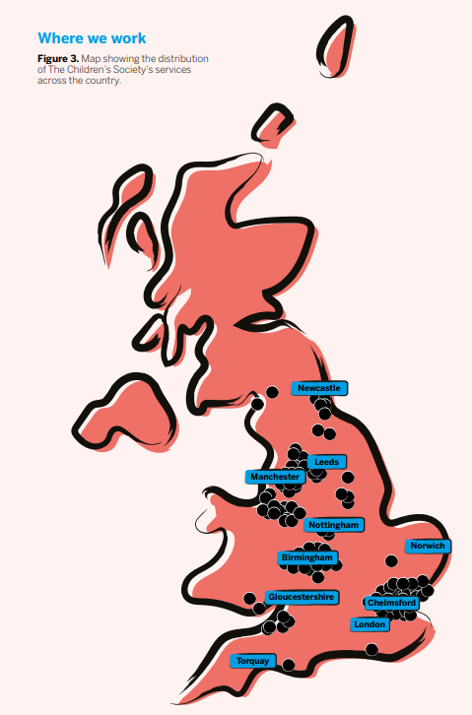
Who we are
A national charity delivering in England and Wales to transform children and young people’s lives:
Provide local support to children and young people
Support those experiencing low wellbeing, or hard such as abuse (including exploitation)
Deliver the national Prevention Programme
Create systems change through policy, research, campaigning and engagement with young people
In 2024/5 we ran 77 direct support services with a focus on providing early support and responding to risk.
Our 40 early support services:
Engaged 52,025 children and young people
Supported 2,446 parents and carers
Our 37 services responding to risk worked with:
5,627 children and young people
1,10 parents and carers

Slide 3




Today we will…
Explore child exploitation: including child sexual, criminal and financial exploitation
Consider the scale of the issue and responses
Centre our work in young people’s voice & experience

Slide 4




What is child exploitation?
Modern Slavery
Child Sexual Exploitation
CSE
Child Criminal
Exploitation
CCE
Child Financial
Exploitation
CFE

Slide 5

Child exploitation is a form of abuse. It occurs when an individual or group takes advantage of an imbalance of power to force, coerce, control, manipulate a child or young person under 18 into an activity that benefits the perpetrator or facilitator. This includes, but is not limited to, sexual and criminal activity, wider forms of labour, forced begging and domestic servitude.
The Children's Society (2024)

Slide 6
Child Sexual Exploitation (CSE)

Slide 7
Child sexual exploitation is a form of child sexual abuse. It occurs where an individual or group takes advantage of an imbalance of power to coerce, manipulate or deceive a child or young person under the age of 18 into sexual activity in exchange for something the victim needs or wants, and/or for the financial advantage or increased status of the perpetrator or facilitator. The victim may have been sexually exploited even if the sexual activity appears consensual. Child sexual exploitation does not always involve physical contact, it can also occur through the use of technology.
https://www.gov.uk/government/publications/child-exploitation-disruption-toolkit

Slide 8
Child Criminal Exploitation (CCE)

Slide 9



Criminal Exploitation
Criminal exploitation occurs when children are groomed to commit any type of criminal activity.
County Lines are phone lines used to organise the distribution of drugs around the UK.
Young people are groomed and then often trapped into committing crime through threats of violence.
Children of any age, race, gender and background can be targeted.
Spotting the Signs:
Travelling alone, particularly in school hours, late at night or frequently?
In possession of more than one phone?
Carrying lots of cash?
Under the influence of drugs or alcohol?
Being instructed or controlled by another individual?
Accompanied by individuals who are older than them?

Slide 10

New Crime and Policing Bill 2025
Will introduce new offence of 'child criminal exploitation'
Allows police to attend lower value shoplifting
Might help to focus on areas of criminal exploitation beyond county line model of drug distribution
Ability to focus beyond 'county lines'
New offence of ‘cuckooing,’ or home invasion

Slide 11

Our policy asks for the bill
The Children’s Society has long campaigned to see young victims of criminal exploitation recognised, rightly, as victims of child abuse, rather than criminalised for offences they have been forced to commit.
But the government can go further to protect young people from harm. We are calling for:
Consistency across the CCE, cuckooing and coerced internal concealment offences – so that young people are not criminalised for their exploitation
Robust, multi-agency statutory guidance that defines CCE and ensures all those with safeguarding responsibilities understand how the new offences around child exploitation
Early support for those at risk of exploitation, and appropriate, holistic support for young victims

Slide 12




Criminal and Sexual Exploitation
Violence, coercion and control are used to criminally exploit as well as sexually abuse and exploit girls.
While girls’ experience of criminal exploitation can vary significantly, it is common for them to be groomed using the relationship model.
Work with girls can be solely focused on CSA
Female victims can be overlooked and under- represented
We fail to safeguard girls effectively if we don’t see all of the harms

Slide 13



Boys with disabilities are more at risk of CSE than girls with
disabilities
Boys and CSE
Perpetrators film sexual acts and then extort their victims further
Coerced internal concealment harms like sexual abuse
Boys being criminally
exploited may also be sexually abused​
3 times as likely as girls to experience CSA by ‘a person in a position of trust’
At least 3 times less likely than girls to describe experiences of CSA
Sexual abuse of boys often
goes
unreported

Slide 14

Barriers to identification and disclosure
Behaviour can be impacted by trauma which may present as anger, aggression, behaviours professionals find challenging.
Masculine norms and internalisation of homophobia may discourage boys from speaking out. As do professionals own perceptions.
Boys might have difficulty with being described as a ‘victim’.
Risk assessments can be ‘female-centric’.
Many boys can report and do want to talk when in a safe space and the right approach.
Not every young person can - we should never wait on a disclosure to act.

Slide 15



Trans and non binary young people
LGBTQ+ children's identities are often dismissed by professionals as the result of sexual abuse. Such dismissal destroys trust between the child and the professional
Signs of sexual activity​
Trans girls and women have often been highly sexualized and othered in society
LGBTQ+ young people have higher rates of poor mental health and homelessness
Trans children are at a high risk of sexual abuse

Slide 16
Child Financial Exploitation

Slide 17

Child financial exploitation
Child Financial Exploitation is a form of abuse. It occurs when an individual or group takes advantage of an imbalance of power to encourage or compel a child under 18 to undertake a financial activity that benefits the perpetrator or facilitator. The perpetrator(s) might coerce, control, manipulate or deceive the young person. This activity is often criminal and therefore a form of Child Criminal Exploitation and includes but is not limited to money laundering and wider fraud.
The Children's Society (2024)

Slide 18





Who is being financially exploited?
Particularly important to consider during transition to adulthood
Children across all socio economic
backgrounds
Anyone can be financially exploited
There was no research

Slide 19

Impact on children
Financial exploitation can have severe and long-term consequences
It has devastating impacts on both children's mental health and their ability to build and sustain trusting relationships
Children are being criminalised
Bank accounts are frozen or shut down

Slide 20
Who is at risk of harm?
Perpetrators adapt themselves to the individual child’s needs, which is why children with high unmet support needs are often the ones which you are encountering in your role.
These children will be reluctant to disclose their exploitation as they perceive that their needs are being met.

Slide 21

Possible indicators of exploitation
Going missing or returning home late
Missing or late for school or education
Unexplained, gifts, money, new possessions
Misusing substances
Spending time or in a 'relationship’
with older peers
STIs, pregnancy, sexual behaviours beyond development
Signs of poor mental health, low self-esteem
Changes in appearance

Slide 22
Which children may be especially at risk of (any type) of exploitation?
Special Educational Needs or a Disability
Experience of physical, sexual abuse or neglect
Missing episodes
LGBTQ+
Mental health or substance misuse issues
Being in care or on the edge of care
Poverty
Victim of crime

Slide 23



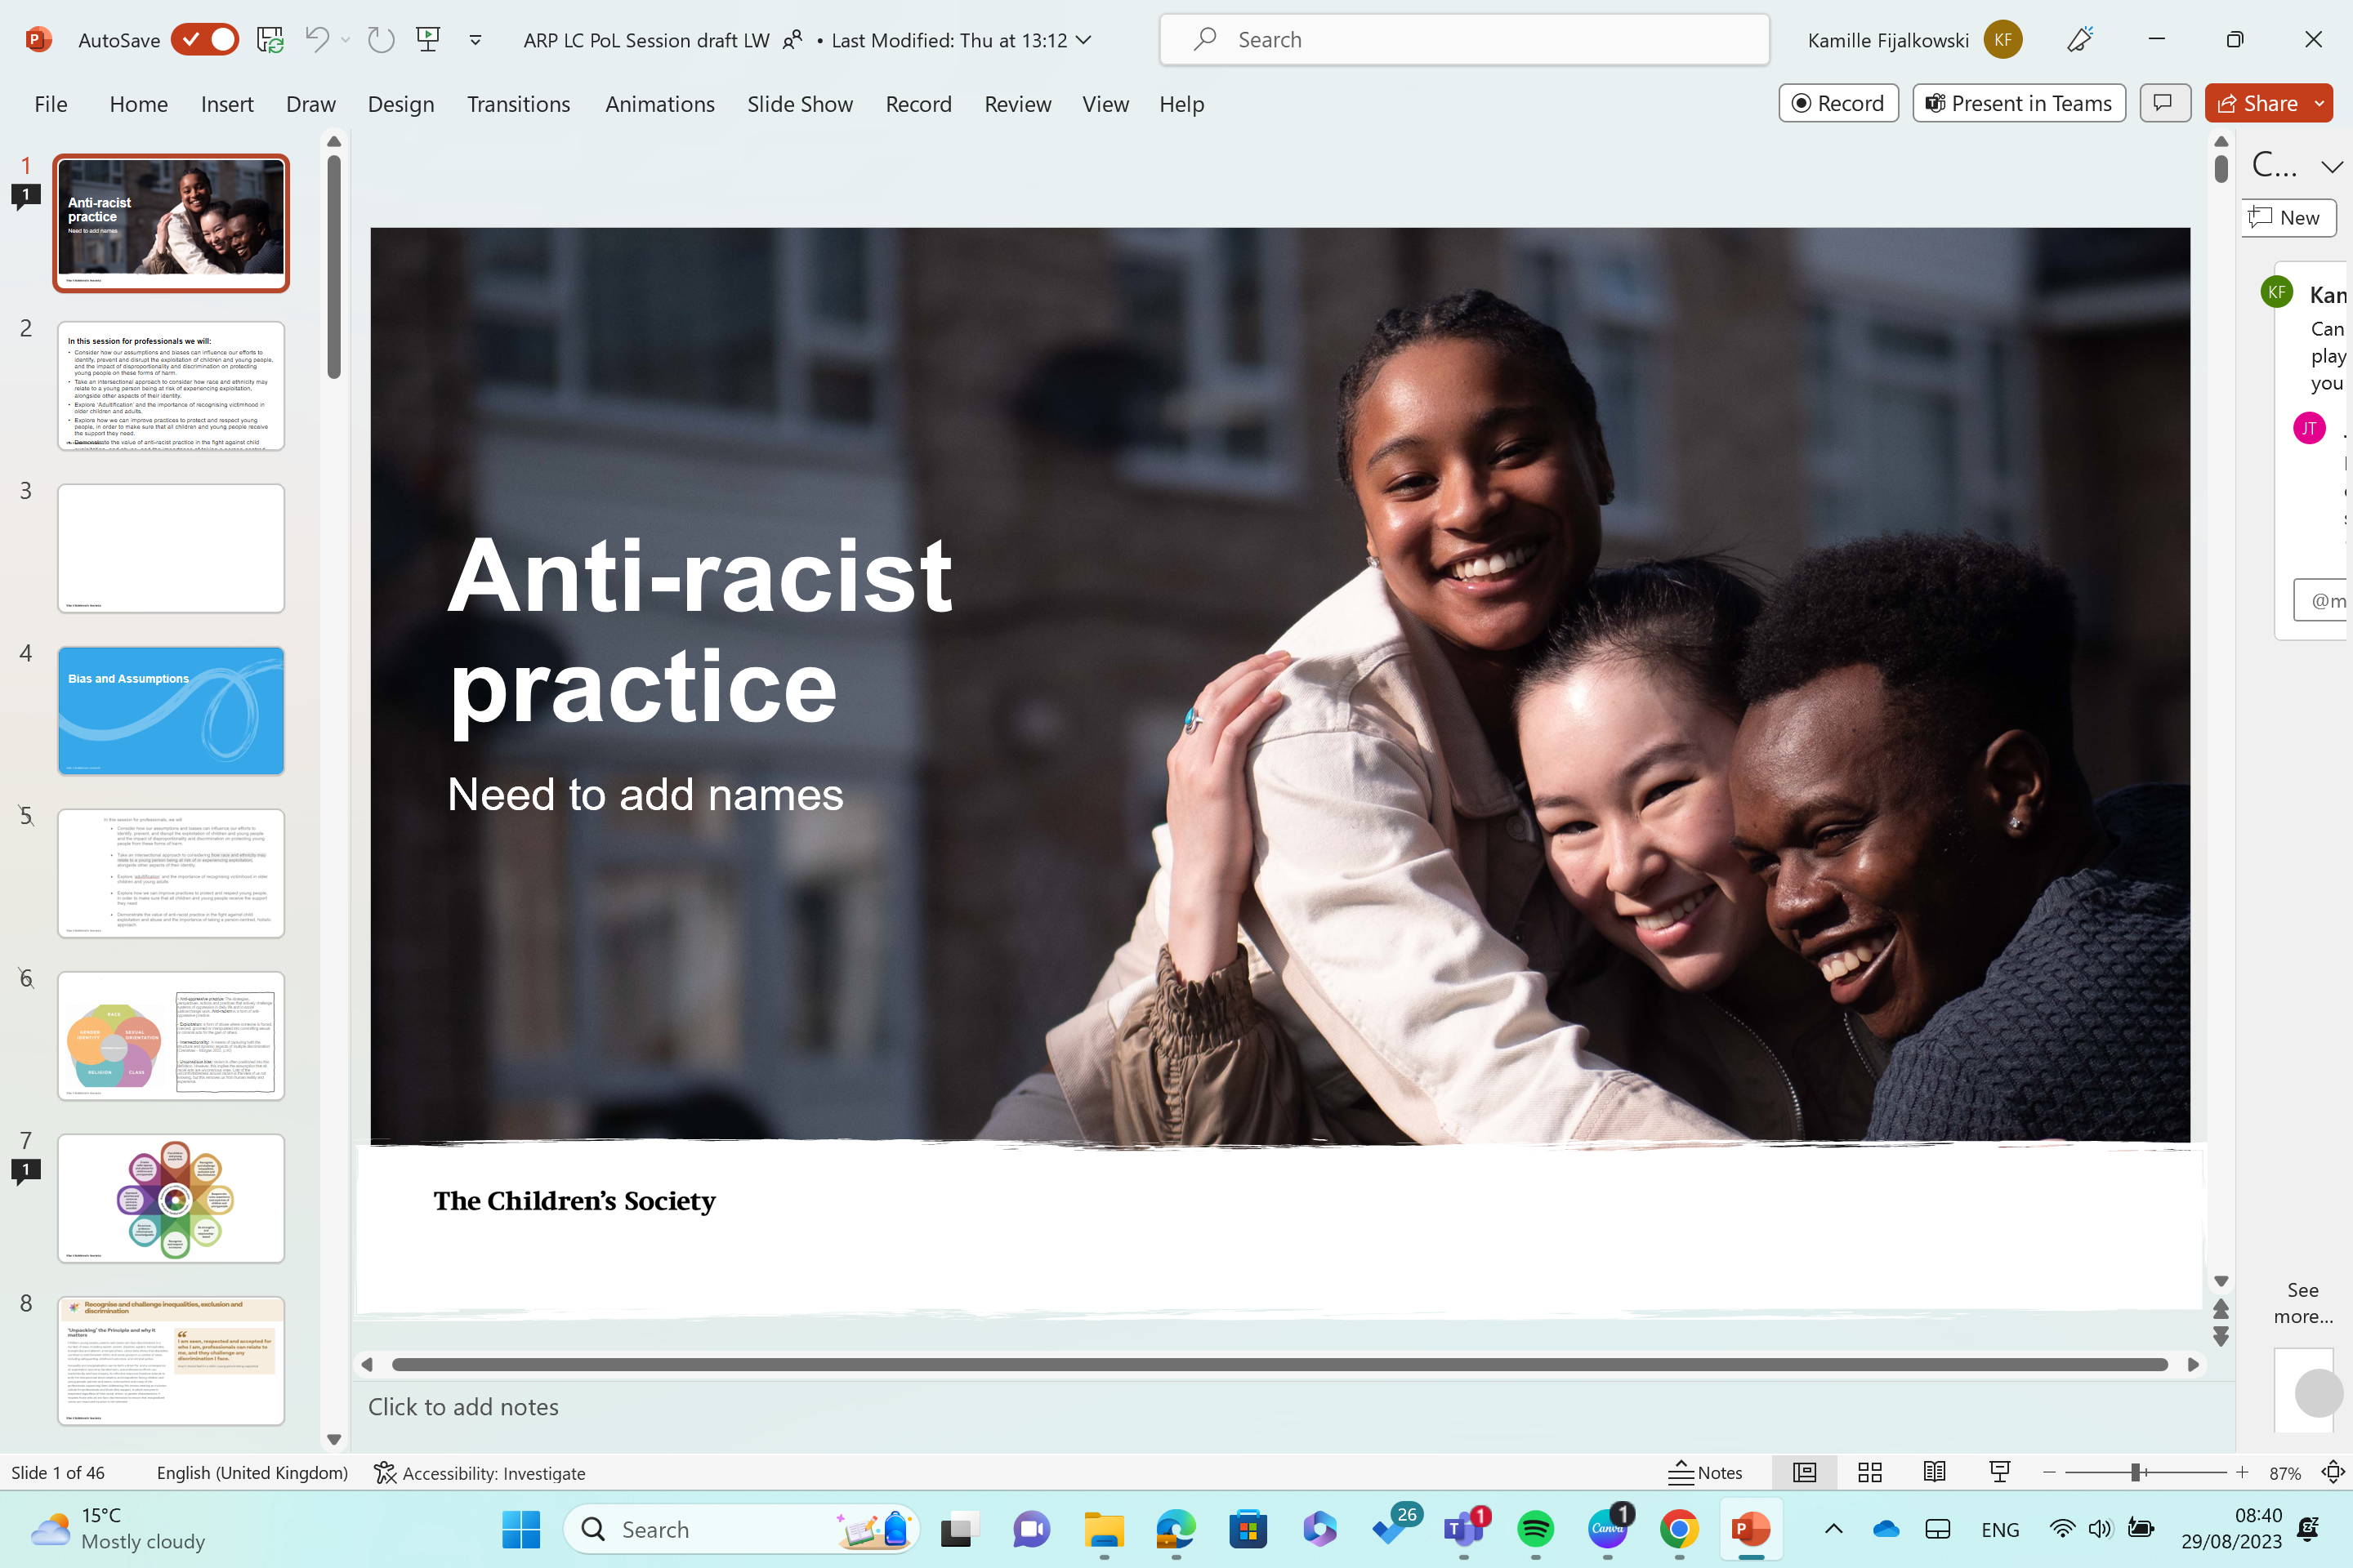
Young people as victims or perpetrators?
The identification, recruitment and entrapment of a child or young person may be by another child or young person who has been subject to the same process.
A young person may have been coerced into exploiting others making them both at risk of harm and a risk to others. We therefore need to understand the needs and vulnerabilities that might be underpinning harmful behaviours.
A safeguarding response is required alongside criminal justice

Slide 24
Scale

Slide 25
What does the data tell us?
According to the ONS, 22,000 children were referred to the NRM as suspected of all forms of sexual or criminal exploitation between April 2016 and 2021.
During the same time frame, only 185 prosecutions were made under the Modern Slavery Act, and only half were successful.
For the year ending 31 March 2024:
2,280 young people (aged 17 or under) were referred into the National Referral Mechanism as potential victims of criminal exploitation
1,503 young people (aged 17 or under) were referred into the NRM and had ‘county lines’ flagged in their referral for the year ending
15,750 children and young people had CCE identified in their child in need assessment

Slide 26
Responding

Slide 27
Local responses to exploitation
We asked 120 LAs if they have a standalone child exploitation strategy:
27% told us they do
36% do not
Of those with strategies:
A third (33%) were not specific to children or adolescents
13% were out of date
Only 20% said their strategies or exploitation services had been evaluated in the last 3 years
Only 10% told us they offered training for councillors specifically on child exploitation in addition to basic safeguarding training

Slide 28
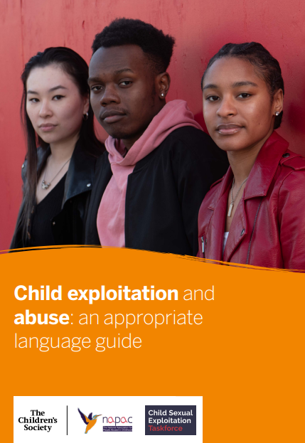
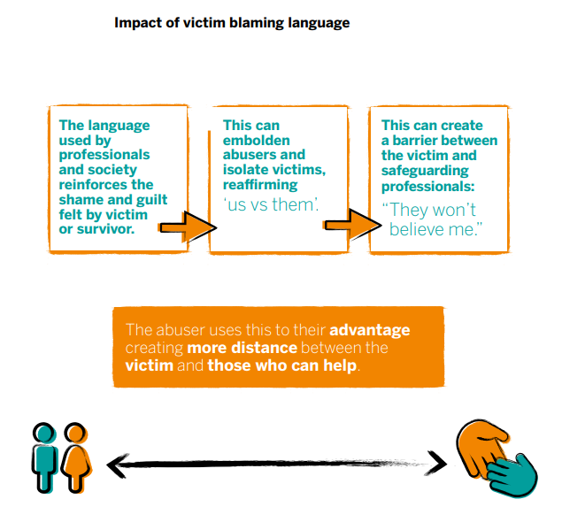


Slide 29



Principles of appropriate language
Avoid victim blaming
Name the crime
Use the active voice
Effective reframing
Gloucestershire OPCC - Words Matter 2025

Slide 30
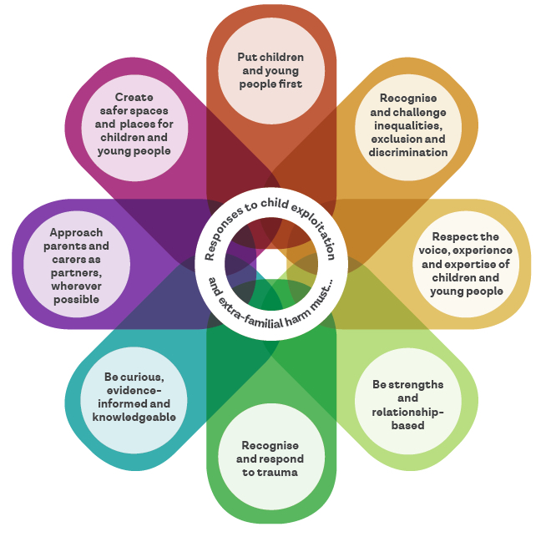


Multi-agency Practice Principles for responding to child exploitation
and extra-familial harm
https://tce.researchinpractice.org.uk/

Slide 31

Safeguarding
Process
Effective prevention & protection
Disruption
Measures

Slide 32
Influencing national responses
The Children’s Society continue to campaign publicly and influence behind the scenes for better national and local responses to all forms of child exploitation.
Consistent approaches to monitoring and recording exploitation
Financial exploitation included in the new fraud strategy
Implement
Baroness Casey’s recommendations
Updated guidance on children going missing
National recognition of the problem of siloed responses
Therapeutic support for young victims
Implement all IICSA recommendations

Slide 33
Young people’s voice & experience

Slide 34
Amplifying young people’s voice
Offences against children change over time but young people’s experiences and the responses to them remain constant:
- They don’t feel safe
- They often don’t feel believed
- They don’t trust the adults in their lives
- They don’t think people in their communities would ever help them
April 2024: direct consultation with young people – placing their voices at the centre of our work to address child exploitation

Slide 35

“People have a stereotype of what an exploiter looks like and what a victim looks like”
“There is more awareness about risk
for girls, so people are more likely to
get involved”
“There are lots of incidences of mistaken identity, where a black young person gets mistaken for someone else and held accountable for something they didn't do”
Bias

Slide 36

Responses to young people
“Security wouldn't intervene if they saw a white girl doing something like having an argument or shouting but they would if it was a black young person, not because they want to help but because they see the black young person as a threat or risk”
“I do not believe members of the public would intervene and help, people are not as nice as they used to be”

Slide 37
How can we respond?
“It's important when engaging with young people to make them feel safe and comfortable”
“Keep keeping the streets safe and give protection to people who are at risk”
“If you are worried about a young person, you could call emergency services even if you are unsure if the situation warrants an emergency response”
“Listen to minorities and allow minoritised kids to speak on their experience”

Slide 38







Voice of the child
Unpack victim blaming views that young people may hold about themselves.
Do not re-enforce the young person's victim blaming narrative about themselves.
Increase empathy towards themselves by exploring circumstance and motivation of abuser.
Take a children's rights-based approach: all children have the right to protection from abuse.

Slide 39



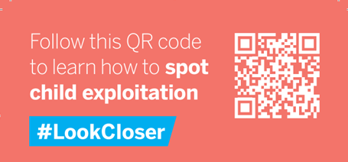
#LookCloser
Across the country, young people are being manipulated, sexually abused, forced to launder money and deal drugs. Exploitation isn't obvious. But it happens everywhere
Together we can stop it
Get to know the signs of child exploitation and how to report it through our award-winning #LookCloser campaign with the British Transport Police and National County Lines Coordination Centre
Together we can protect children from this abuse

Slide 40
